Slide 1
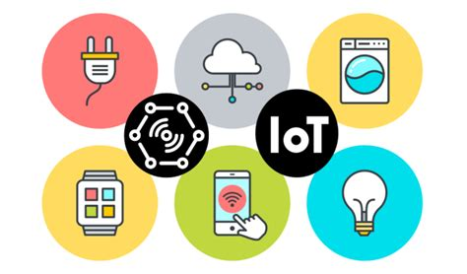
IoT Security Research Project
By Abdur-Rahmaan Baghdadi
(UTSA Cyber Center for Security and Analytics)
May 22, 2020

Slide 2
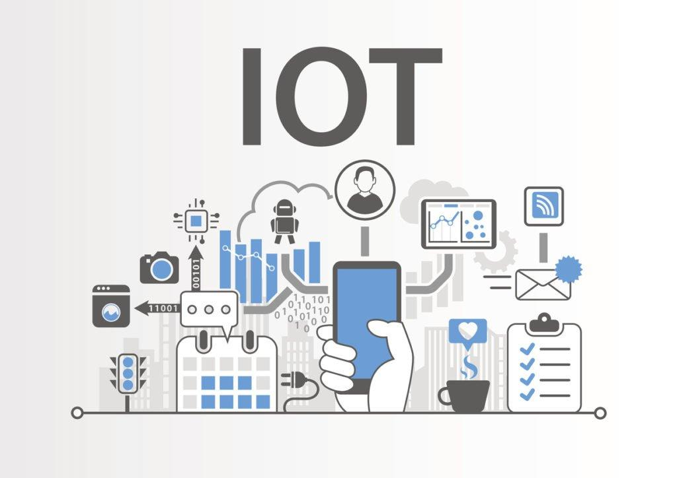
Overview
Introduction to the Internet of Things
Intro to Hardware and Software Systems
IoT Vulnerability Research
Hypothesis
Additional Research
Takeaways from the project

Slide 3
Introduction to the Internet of Things (IoT)
1

Slide 4

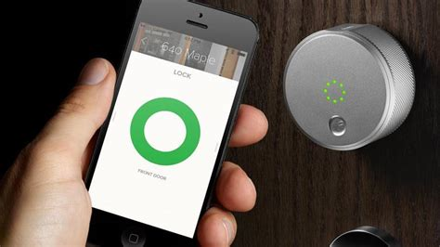
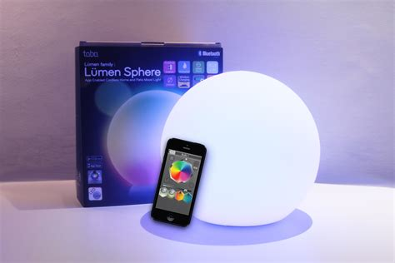
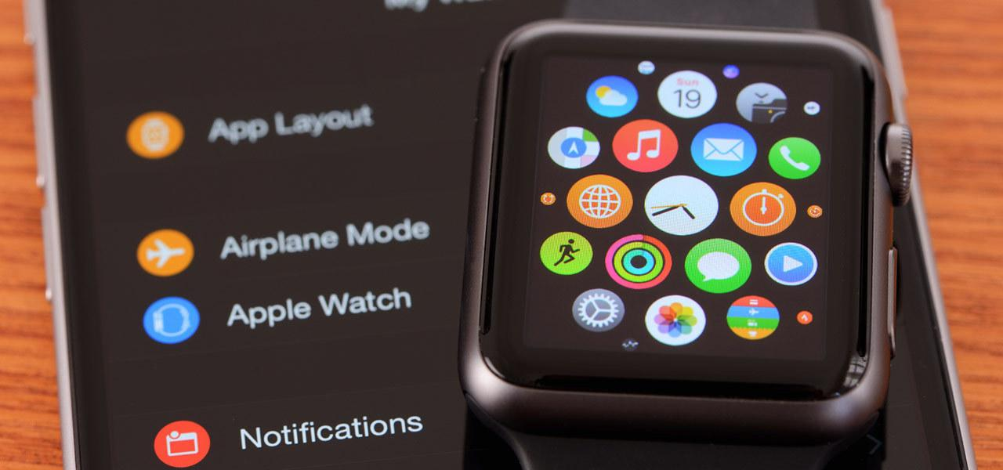
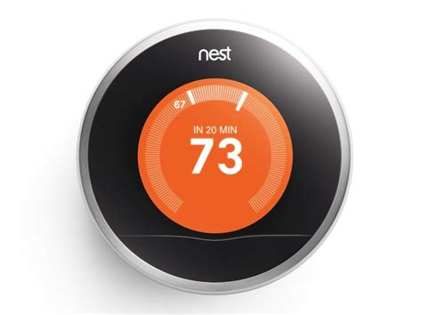
The Internet of Things (IoT)
IoT
“There are 26.66 billion active IoT devices in 2019”(Nick G, Techjury)
EX. Coke vending machines, smart watches, Smart Home lights, and many more.
What is the internet of things?
The IoT is a system of interconnected devices
IoT devices are used in many homes and office environments
Ex. Alexa and Google Home devices
Specific identifiers, UIDs, are used to guide direct data transfers between devices
IoT History
IoT first started with a project done at the Carnegie Mellon university, where students got together to develop a basic system to keep track of how many cans a vending machine had.

Slide 5
Intro Hardware and Software Systems
2

Slide 6
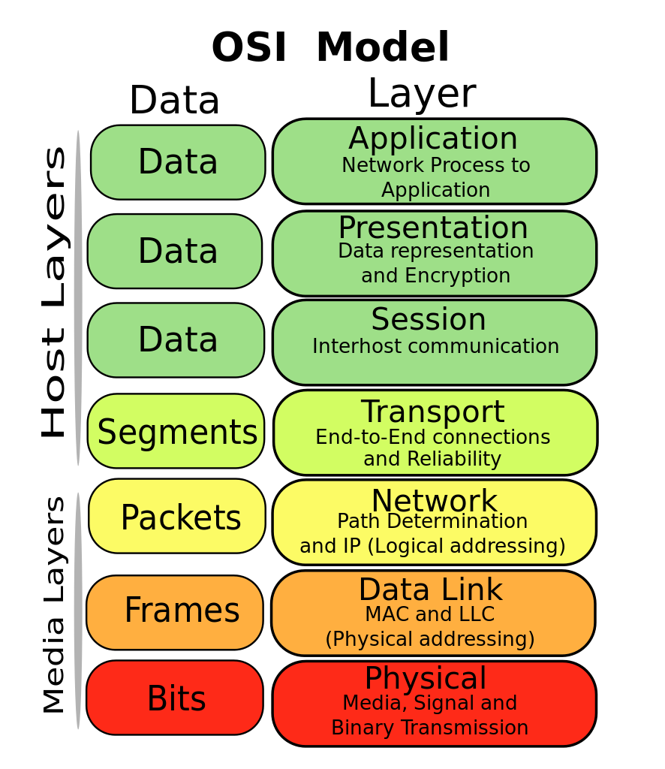
OSI Model
(Open Systems Interconnection)
OSI : “an international standardization model to facilitate communications among computers with different protocols” (dictionary.com)
The OSI model Consist of 7 Communication layers
Application, Presentation, Session, Transport, Network, Data Link, and Physical
Each communication layer may have vulnerabilities
Vulnerability analysis should take place at each layer
Image from Gorivero / Wikimedia Commons / CC-BY-SA-3.0

Slide 7
OSI Model
(Open Systems Interconnection)
Browser places packets together in a webpage
Breaking down and transporting the packages
Ip addresses send packets between devices
Electrical signals
Image from Gorivero / Wikimedia Commons / CC-BY-SA-3.0

Slide 8
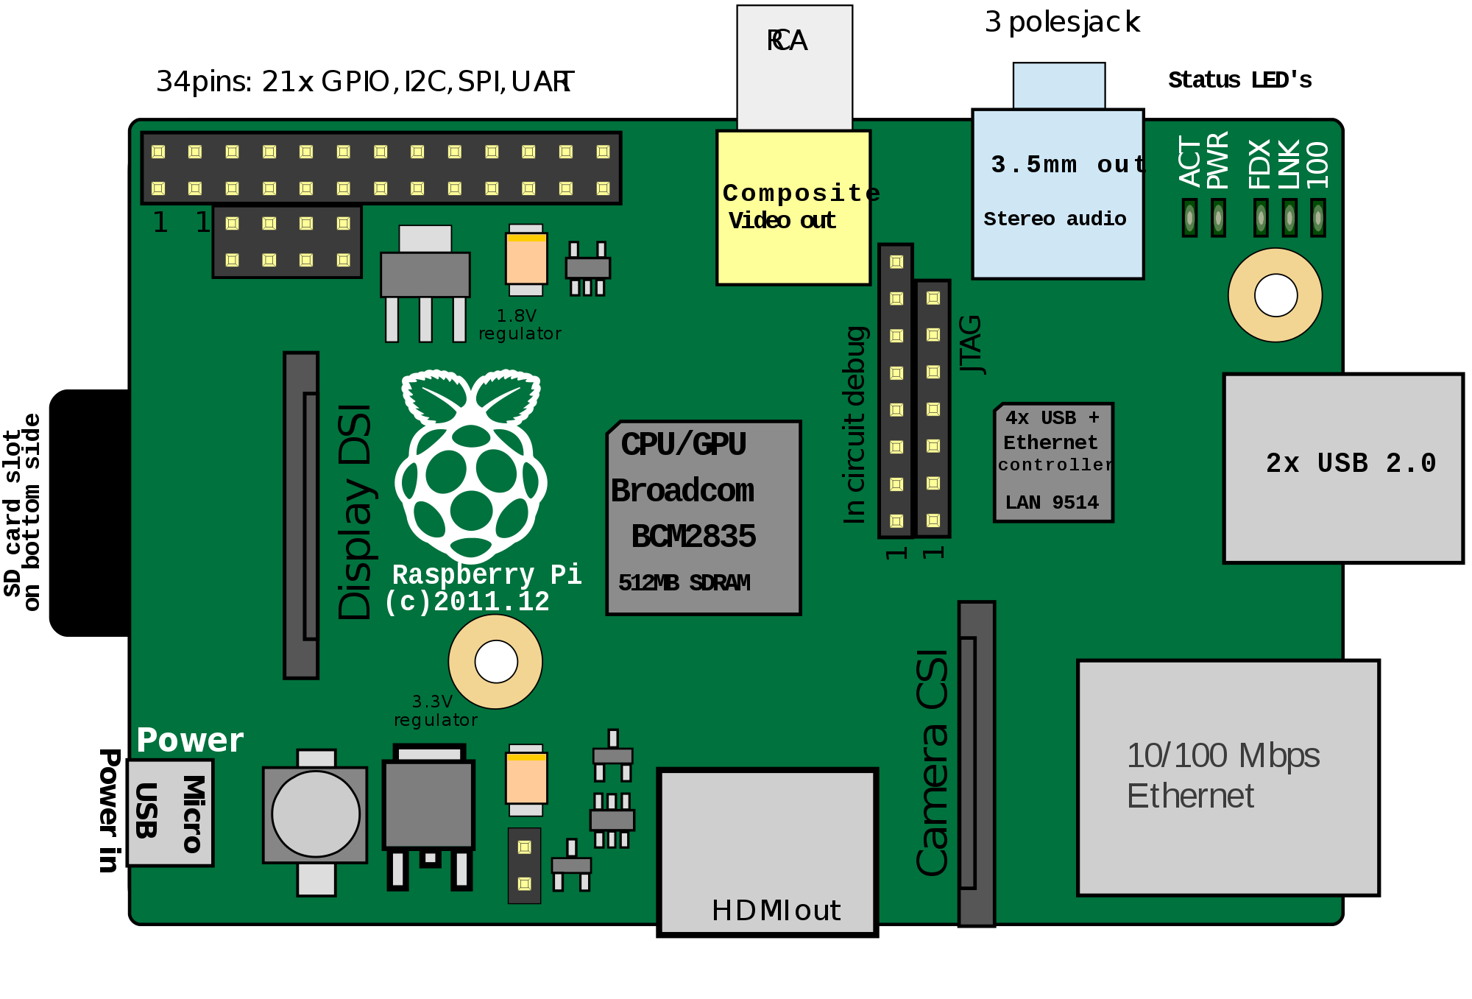
UART Data
(Universal Asynchronous Receiver-Transmitter)
UART is communication between the chips on the board and an external device
Using a controlled board such as a raspberry pi communications can be interrupted
4 Base UART pins
Gnd (ground connection)
Data output: receive (RX)
Data input: transmit (TX)
Voltage (vcc)
UART communication can be exploited to control a IoT device
Image retrieved from https://www.quinaptis.com/2019/03/raspberrypi/

Slide 9
JTAG
JTAG was named after the Joint Test Action Group developed to debug chips
Similar to UART data, JTAG data can be used to exploit an IoT device
TAP (Test Access Port) is the name given to the JTAG interfaces.
Image retrieved from https://www.quinaptis.com/2019/03/raspberrypi/

Slide 10
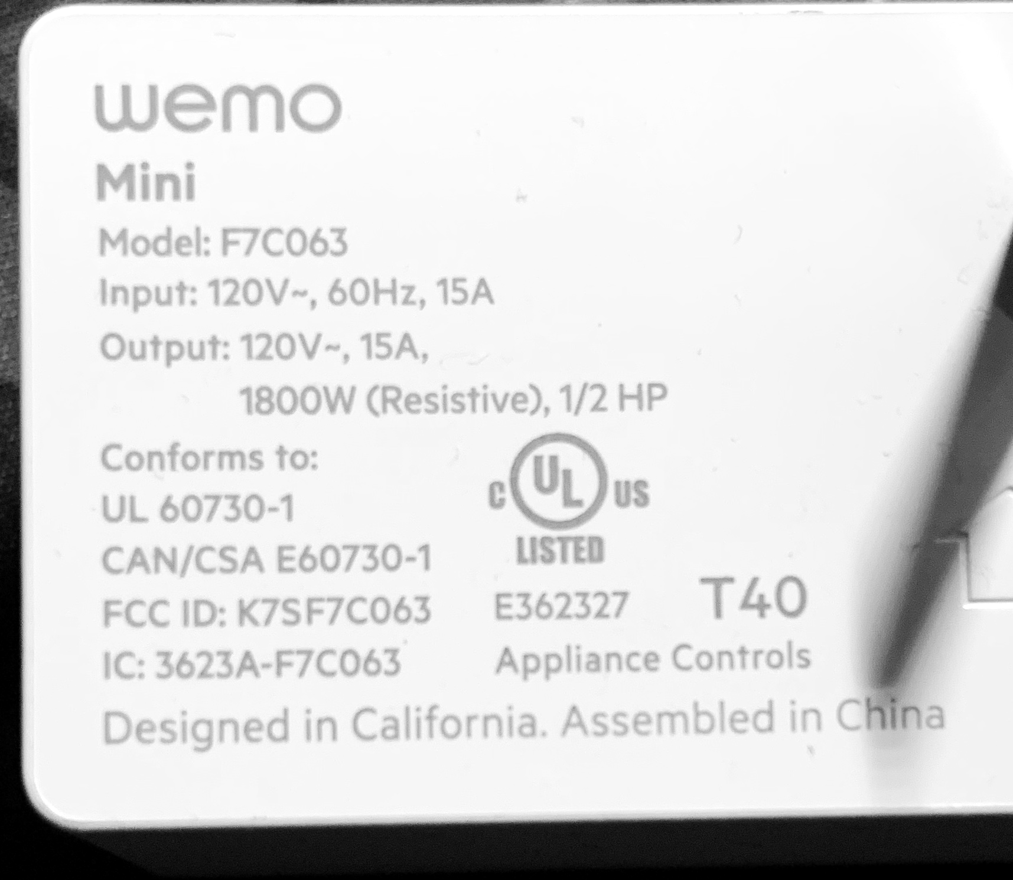
FCC (The Federal Communication Commision)
The FCC is a government institution that monitors and manages radio and radio-like communications between devices
The FCC ID is a tag that most radio devices have. This ID refers to a index where the FCC provides information about the communications used in the device.
In the world of cybersecurity the information provided allows analyst to see the frequency and communication protocol used by the devices
The information then allows for people to search on certain wavelengths to fetch data

Slide 11
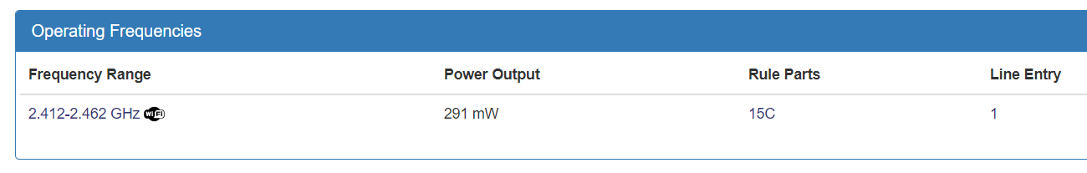
(FCCID.io)

Slide 12
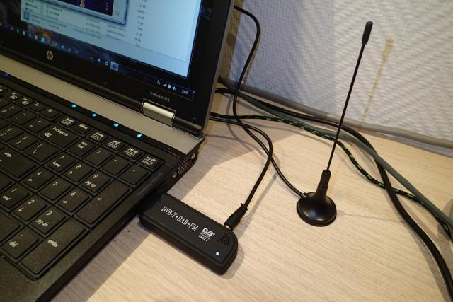
DATA Sniffing and Wiretapping Legalities
Software Defined Radio (SDR) antennas can be used to capture data packets from devices
Signals that have not been encrypted correctly and that are insecure forms of communication can leak information
Laws addressing wiretapping place repercussions for listening to data that does not belong to the host
Image Retrieved from https://ezcontents.org/software-defined-radio-rtl-sdr-usb-dongle

Slide 13
IoT Vulnerability Research
3

Slide 14
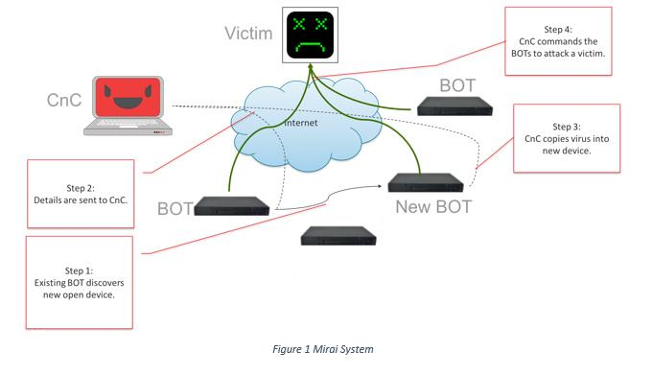
Mirai Botnet
In the past, Malware attacks have shown insecurities in IoT devices
The Mirai Botnet Attack was a malware driven compromise of the internet of things
The malware used widespread DDoS attacks in order to compromise devices
Each additional device compromised then searched for more vulnerable devices to add to the expanding botnet
Mirai took advantage of insecure default passwords.
The Impact: After Mirai the internet released the source code for the attack causing security researchers to be concerned for future attacks of a similar nature that may occur
Image from https://opensourceforu.com/2019/10/the-role-of-open-source-tools-and-concepts-in-iot-security/

Slide 15
Technical Vulnerabilities
(common methods for device infiltration)
Default user IDs and passwords
Device is insecure
By using the default id and password unauthorized users can connect to and infiltrate the device
This method was key in the mirai botnet
IP Address and Network Vulnerabilities
By leaks in IP addresses and insecure networks exploiters can gain access to user interfaces and control a device or deny service to the device

Slide 16
Technical Vulnerabilities (Cont.)
Insecure Data Transfer
Through basic internet data sniffing and network monitoring packets can be leaked
If data is not secure and does not have safe encryption data can be stolen
Insecure Access Points
Ex: insecure mobile applications
Using testing to gain access to insecure points in application systems can leak data and give total access to the control systems

Slide 17
Hypothesis
If these patterns in device vulnerabilities are repeated in the future, Smart Home and Office spaces will be at risk.

Slide 18
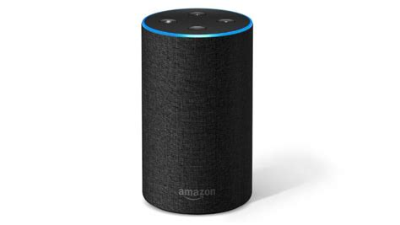
Developing the Alexa Farm
To start the Project I helped members in the lab setup devices in an attempt to demonstrate a possible Smart Office environment with integrated alexa devices
This setup was connected to a internet proxy with a raspberry pi in order to be able to monitor data capture within the lab environment and record it
Amazon Echo (alexa)
Lightbulb
Printer
TV
Air data collection device
Camera
Robot Vacuum
Thermostat
A lock
Image from https://www.zdnet.com/pictures/internet-of-things-gadgets-to-make-your-home-smarter/3/

Slide 19

Creating data capture for the office environment
In the lab two data collection systems were studied.
Both of these softwares collect records of all the data packets sent within the internet connection between devices.
These records can be used for monitoring and recording the experiments and testing in the lab
ELK
E = elasticsearch (Search engine)
L = logstash (Translating data)
K = kibana (user interface)
ROCK NSM
Uses a ELK system with other softwares to better monitor internet connection
Image from https://rocknsm.io/

Slide 20
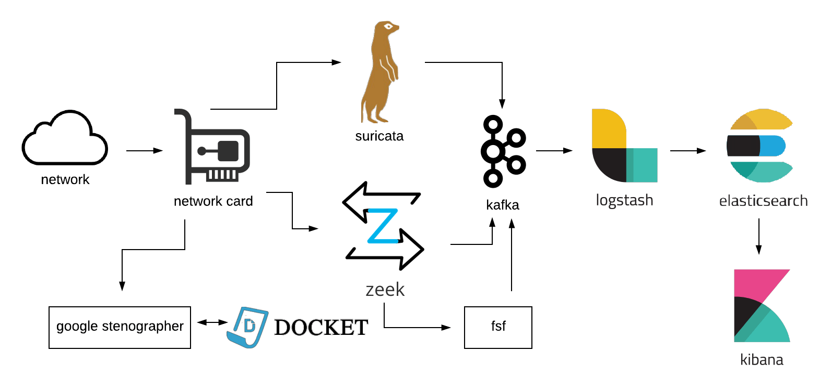
Rock NSM
Image from https://rocknsm.io/

Slide 21

Testing Devices (Lightbulb)
Using Data packets captured, the lab was able to test responses in lightbulbs sending those packets to evoke unauthorized commands

Slide 22
Additional Research/Future Expectations
4

Slide 23
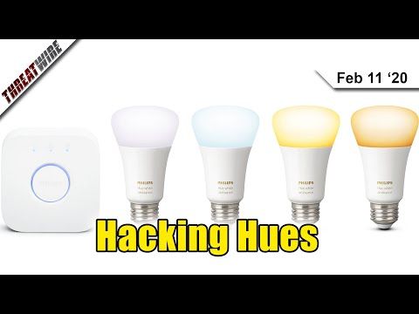
Lightbulb Network Data Breach

Slide 24
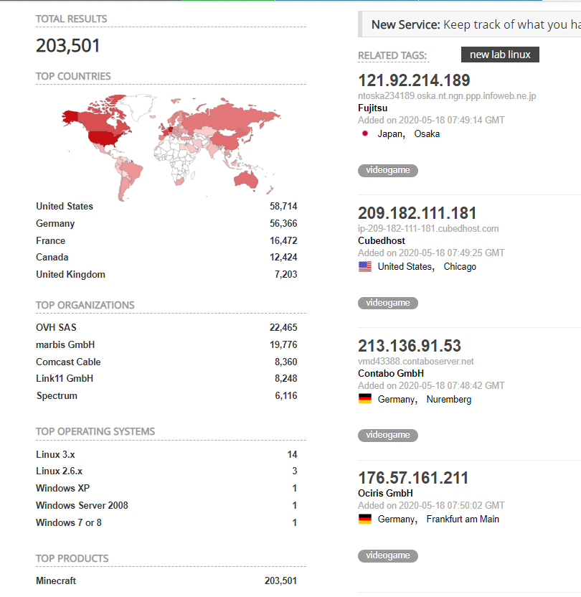
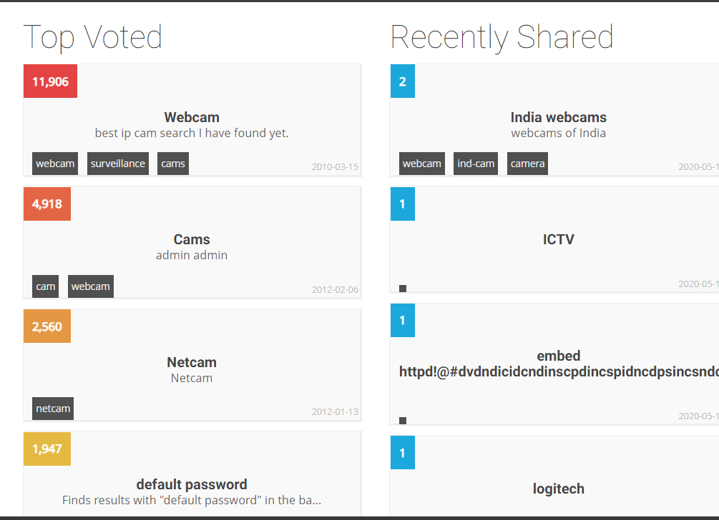
Shodan
https://www.shodan.io/

Slide 25
Takeaways
5

Slide 26
Things to remember
Not all devices are safe! Be sure to keep updated!
IoT researchers are continuing to learn more and test vulnerabilities
Data sniffing is illegal! Still watch out!
Possible Mitigations can solve insecurities in IoT

Slide 27
Special Thanks to
Oren Upton
Julia Cottle
April Garza
David King
UTSA
BASIS
Teachers

Slide 28
Sources
G, Nick. “How Many IoT Devices Are There In 2020? More Than Ever!” Tech Jury, Techjury, 16 Jan. 2020, techjury.net/blog/how-many-iot-devices-are-there/.
Gupta, Aditya. The IoT Hacker's Handbook: A Practical Guide to Hacking the Internet of Things. Apress, 2019.
Hak5, director. Hacking Philips Hue Lights To Hack Whole Networks - ThreatWire. YouTube, YouTube, 11 Feb. 2020, www.youtube.com/.
Pahwa, Ahyan, director. Reverse Engineering- IoT Smart Light Bulb | Syska Smart Lights | Hack Bluetooth | BLE | IoT. YouTube, YouTube, 6 Aug. 2017, www.youtube.com/.

